Slide 1
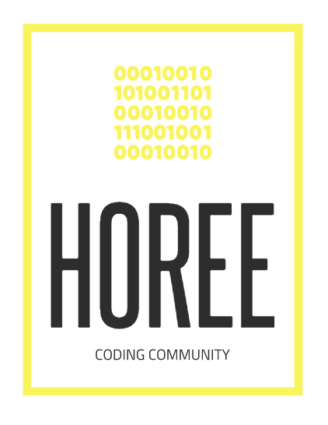
YUSAK SETIAWAN

Slide 2
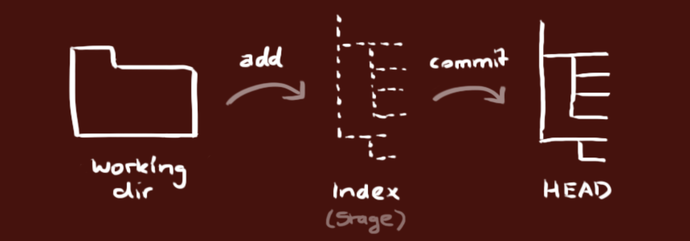
GIT (lanjutan)
Git Init
Init your local folder to be managed by git
git init
Git Add
Add files to be managed by git (in the git folder)
git add *
Git Commit
Commit any changes to the head
git commit –a –m “yourmessage”

Slide 3
GIT (working with remote repository)
Git Remote Add
Add a remote url to push / pull our local repository
git remote add <remoterepositoryname> <server/url>
to check git remote –v
Git Clone
Cloning / copy a remote repository to local
git clone <url>
Git Push
Copy all commits from your local to remote repository
git push <remoterepo> <branch>
Git Pull
Copy all commits from remote repository to local
git pull <remoterepo> <branch>

Slide 4
GIT (Branching)
Git Branch
Show available branch in your local repository
git branch
To check the branch in remote git remote show origin
Branching existing branch to a new branch git branch <branch>
Git Checkout
Set active branch, or get / checkout a file or files to a particular
git checkout <branch> or git checkout –b <branch> create a new branch and checkout

Slide 5
Basic Programming
Algoritma
Languages
Naming Convention
Data Type
Operator
Conditions
Loop
OOP (Object Oriented Programming)

Slide 6
Algoritma (Basic Programming)
A step-by-step to solve a particular problem.
Many Algoritma to solve problem,
Contoh: Searching, Finding Path, etc
Pe-R
Algoritma Sorting
Hanoi Tower

Slide 7
Languages (Basic Programming)
How do we choose the language?
You must know the considerations
Interpreter vs Compiler
Field of use
Notes:
Front-End
Back-End
Fullstack
Data-Science
AI / Machine Learning

Slide 8
Interpreter VS Compiler
 | INTEPRETER | COMPILER
PENGERTIAN | Program yang mengubah high-level programming language to machine code baris per baris ketika aplikasi mulai dijalankan. | Program yang mengubah high-level programming language to machine code.
FIRST EXECUTION | Lebih cepat dikarenakan tidak menganalisa seluruh source code secara menyeluruh | Lebih lambat dikarenakan sebelum menjalankan aplikasi, compiler akan menganalisa seluruh source code terlebih dahulu, sehingga sedikit lebih lama
MEMORY USAGE | Lebih rendah pemakaian memori, karena intermediate code tidak di generate secara kesuluruhan. | Lebih banyak pemakaian memorim dikarenakan seluruh source code di ubah menjadi intermediate code, dan ada proses linkin sehingga membutuhkan lebih banyak memori
APPLICATION EXECUTION | Lebih lambat, dikarenakan setiap perintah harus di terjemahkan menjadi machine code, pada saat itu. | Lebih cepat, karena semua source code sudah di terjemahkan ke dalam machine code

